Slide 1
Experian
Data Breach
Solution

Slide 2
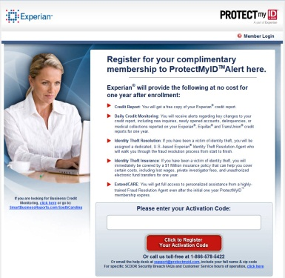
Experian Solution for SC DOR Breach
Enrollment Website
Experian
Credit Report
Upon enrollment
Tax Payer
3 Bureau Monitoring
Call Center
Experian
Fraud Resolution Agents
SERVICES
$1 Million Insurance Policy
(if Adult has dependents)
Fraud Resolution
Alerts & Notifications
ID Theft Issue

Slide 3
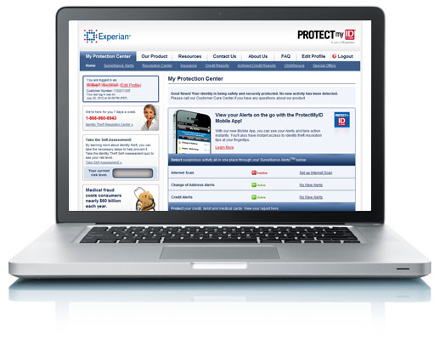
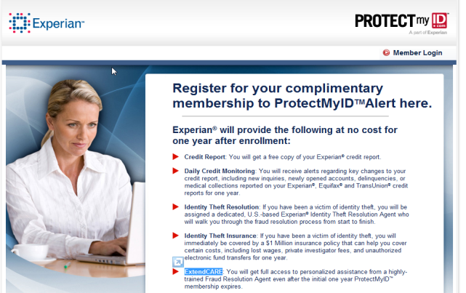
ProtectMyID® Alert
1 year membership
3B Monitoring
Experian Credit Report upon sign up
U.S.- based customer support 7 days/week
No credit card collected
Online and phone enrollment
Choice of email or mail delivery
$1M Identity Theft Insurance¹
Access to Fraud Resolution Agents
ExtendCARETM – fraud resolution beyond the life of the free ProtectMyID membership
¹Identity Theft Insurance underwritten by insurance company subsidiaries or affiliates of Chartis Inc. Please refer to the actual policies for complete terms, conditions, and exclusions of coverage.

Slide 4
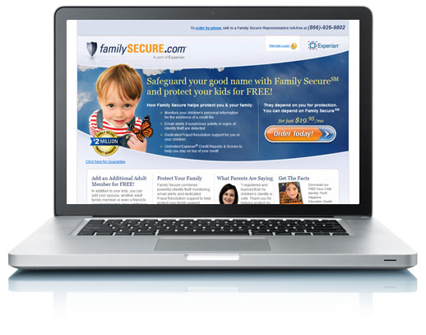
Family Identity Protection Products
FamilySecureSM
$2,000,000 product guarantee
Monitors children’s personal information for existence of credit file
Fraud resolution services
Experian report upon enrollment
Unlimited Experian credit reports and scores for adult subscriber

Slide 5
Overview of Solution Benefits
Experian Data Breach Services:
Created a single-use code to help facilitate the enrollment process without the state having to send out written notifications with single use codes
Set up a call center within a four hour time period with a personalized voice recording and were able to take calls almost immediately
Provided the Business Credit product at no charge
Provided adult and child products for one set price
Facilitated the enrollment process for Family Secure by sending notifications to those enrolled in PMID and providing them a code to utilize if they required it
Provided an alternative process for those individuals without a credit file – monitoring for the creation of a credit file
Dedicated core set of call center agents to help address SCDOR calls (other agents will take overflow calls)
Created an 800# for individuals to call for assistance with enrolling in the product
Customized language on the landing page for enrollment
Public Relations support

